Slide 1
Garnock Massage Programme
Massage strokes to try

Slide 2
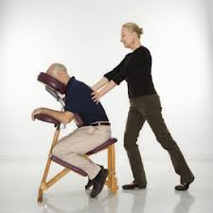
Massage Position
The person receiving the massage sits on a chair the wrong way for writing.
The person ‘administering’ the massage stands behind the receiver.
Always ask PERMISSION

Slide 3
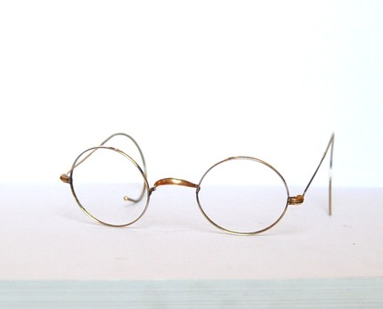
Eye Glasses
Make circles using each hand
Work around the shoulder blade area

Slide 4
Cat Grip
Gently pinching the back of the neck
Do this slowly and steadily
Repeat 6 – 10 times

Slide 5
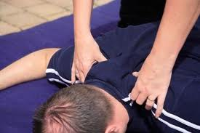
Baker/kneeding the Dough
Imagine you are a baker kneading the dough
Use relatively firm gripping actions
Repeat for approx 30 seconds

Slide 6
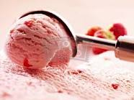
Ice Cream Scoop
Using one hand at a time
Imagine you are scooping ice cream out the tub
Use swift and vigorous movements

Slide 7
Forehead Stroke
Stand behind your partner and place both hands on their forehead (as though your were covering their eyes)
Gently separate hands using your fingers to trace along the forehead

Slide 8
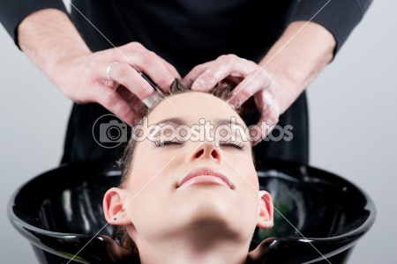
Hairdresser
Imagine you are about to wash your partners hair
Use your finger tips to work in imaginary shampoo
Cover the whole of the head

Slide 9
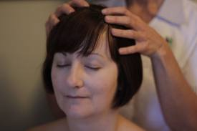
Head and Shoulder Slide
Start with both hands on top of partners head.
Slide your hands down the sides of your partners head.
Continue down the neck and along to the tops of their shoulders
Repeat 6 times

Slide 10
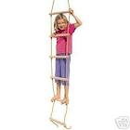
Climbing down a rope ladder
Using your hands to pat the sides of your partner backs. (as though you were climbing down a rope)
work from the top down each time.
Repeat 4 times

Slide 11
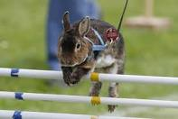
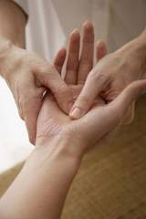
Bunny Hops
Using your 2 middle fingers
Start tapping the palm of your partners hand with your two fingers
Hop your fingers up past the wrist, along the forearm, past the crease of the arm and towards the shoulder.
Repeat on both sides

Slide 12
Hearts
Starting with your hands in the middle of your partners back
Trace the outline of a heart with both hands going in opposite directions
Hands should meet at the base of the spine.
Repeat this 6 times

Slide 13
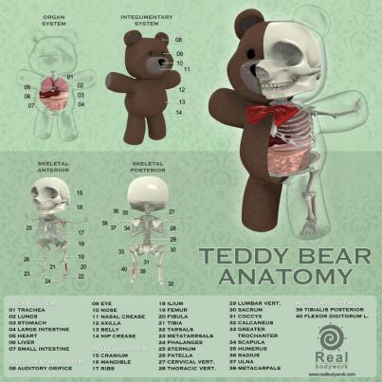
Bear Walk
Start by putting pressure on the heel of your hand, then walk your hand through until only fingers touching your partners back.
Walk each hand alternatively up the spine
Start at the base of spine and progress to the top
Nb work either side of actual bone

Slide 14
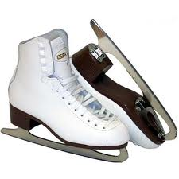
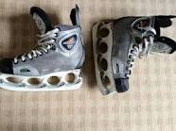
Ice skating
Use the edge of your hands like the blade of the iceskates.
Now slide your blades either side of your partners spine.
Continue this for approximately 30 seconds

Slide 15
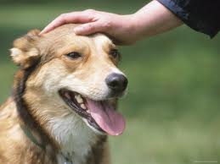
Patting the Dog
Start at the top of your partners head.
Using one hand and a continuous motion stroke from the head down to the base of the spine
As you finish, the other hand should be starting.

Slide 16
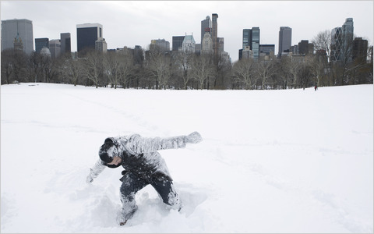
Brushing off the Snow
Vigorously use alternative hands to imagine that you are brushing snow off of someones shoulders back and arms.

Slide 17
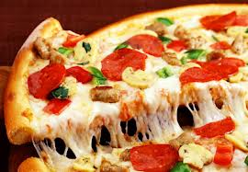
The Pizza
Image your partners back is the kitchen work top where you are about to prepare a home made pizza.
Now make up a ‘massage stroke’ for each of the following stages of making your pizza
Kneading the dough
Rolling out the pizza base
Cutting off the edges
Spreading the tomato paste
Grating the cheese
Sprinkling the cheese
Cutting up the peppers
Cutting up the mushrooms
Cutting up the onions
Placing the pepperoni
Spreading out the ingredients
Grinding the pepper
Sprinkling the herbs
Sliding into the oven
Timer on (hairdresser massage for a countdown of 10)
Sliding out the oven
Slicing up the pizza

Slide 18
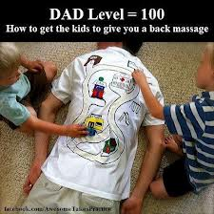
Car Journey Massage
Imagine you are going on a car journey around the country stopping at the :
Sea side
Mountains
Shops
You have to travel via
Big round-abouts
Fast motorways
Winding country roads
Traffic lights etc
Can you make up some massage strokes to go along with the journey you take?

Slide 19
The Weather Report
You are going to explain the weather for tomorrow. We are going to have 4 seasons in one day so include various types of weather:
Starting with patchy Sunshine
Mist on the high grounds
Low cloud
Heavy Rain
Thunder and lightning
gentle winds
Light covering of snow
Gale force winds
Clouds parting
reveal a bright sunny evening
In addition you will use light sweeping motions as you explain how:
the cold weather fronts will be moving in from the north sea and across the country
as well as a warm weather front with high pressure coming up from Europe cooling as it reaches the highlands and islands of Scotland.
Finish with some advice about wrapping up warm for a cold, crisp night
Vigorous rubbing on the outer sides of the back to heat and invigorate

